Slide 1
THE 13TH BIENNIAL LAKE SYMPOSIUM
Topic : Biodiesel extraction from Algae
Amogh S Nadig
Nethra K P
Sanika N
Class:10

Slide 2
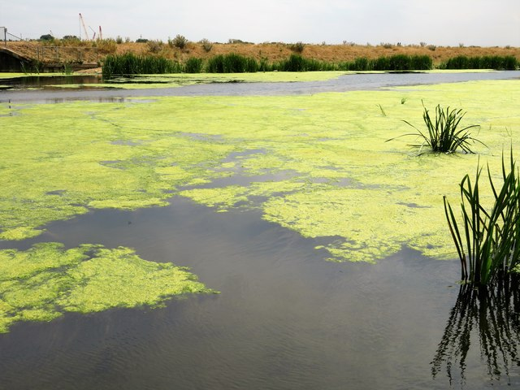
Objectives
Extraction of oil from algae and it’s conversion into biodiesel.
To study an alternative to diesel- Biodiesel.

Slide 3
Introduction
According to a report published by Meddocs International, world energy demand rises by 1.3% every year.
It is anticipated that coal reserves could be available up to 2112 while oil and gas will be depleted by 2040 respectively.
Additionally, biodiesel possesses significant environmental benefits as it is highly biodegradable, nontoxic, safe for storage and handling, it burns much cleaner than petroleum diesel and therefore reduces most exhaust emission .
Biodiesel may be effectively used as both, blend with conventional diesel fuel and in a pure form.

Slide 4
Principle
Oil + alcohol → biodiesel + glycerin
Biodiesel is an alternative fuel for diesel engines that is produced by chemically reacting biolipids ,with an alcohol such as methanol or ethanol.

Slide 5
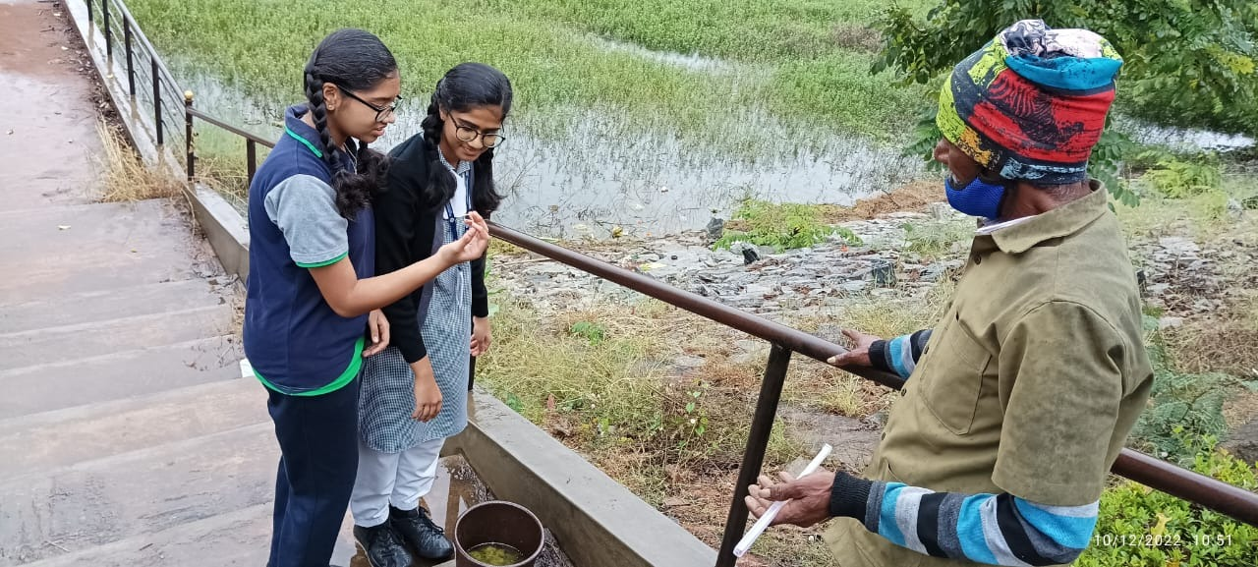
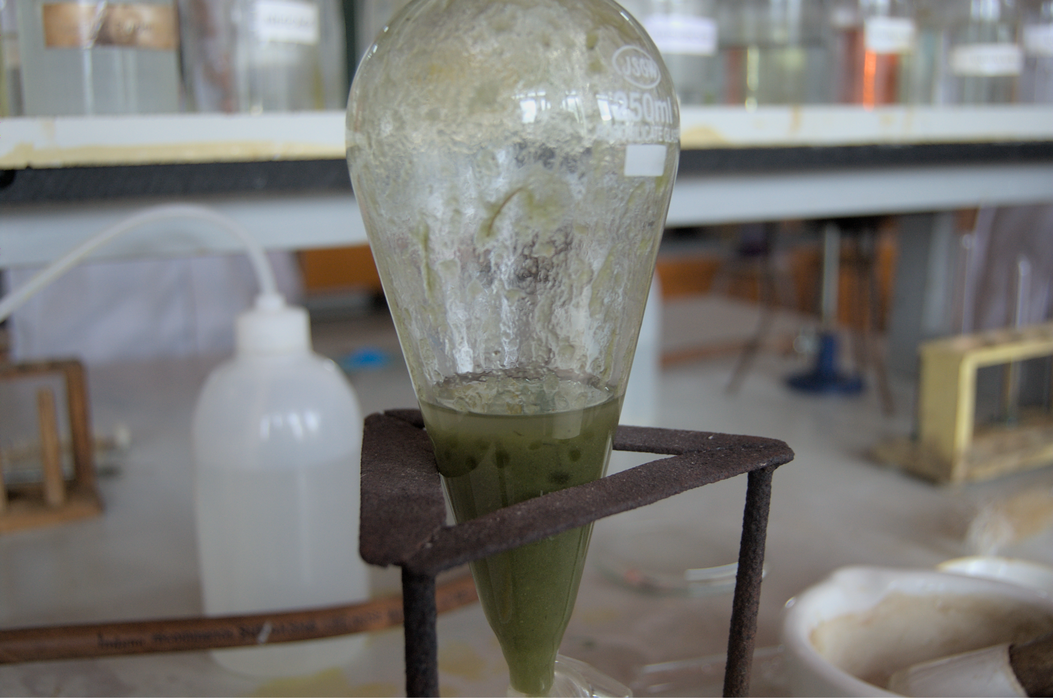
Materials and methods
1 ) Folch Method (obtaining algal oil)
Re-agents: chloroform, methanol, saline water.
Materials Used: algal bloom, separatory funnel, china dish, test tubes, . . beakers, bunsen burner and tripod stand.

Slide 6
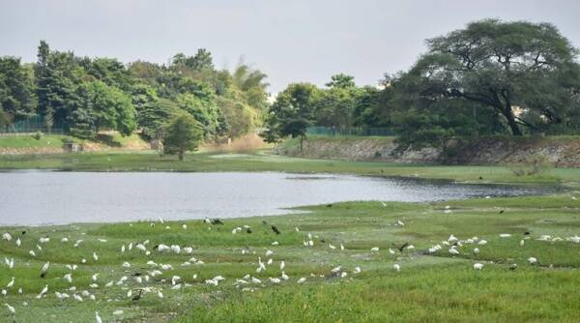
Study Area
Harvesting of algae was done in Ullal lake, using the plankton net.
The temperature of water at which it was harvested was 21°C.
The pH of the water was 7 ( neutral).

Slide 7
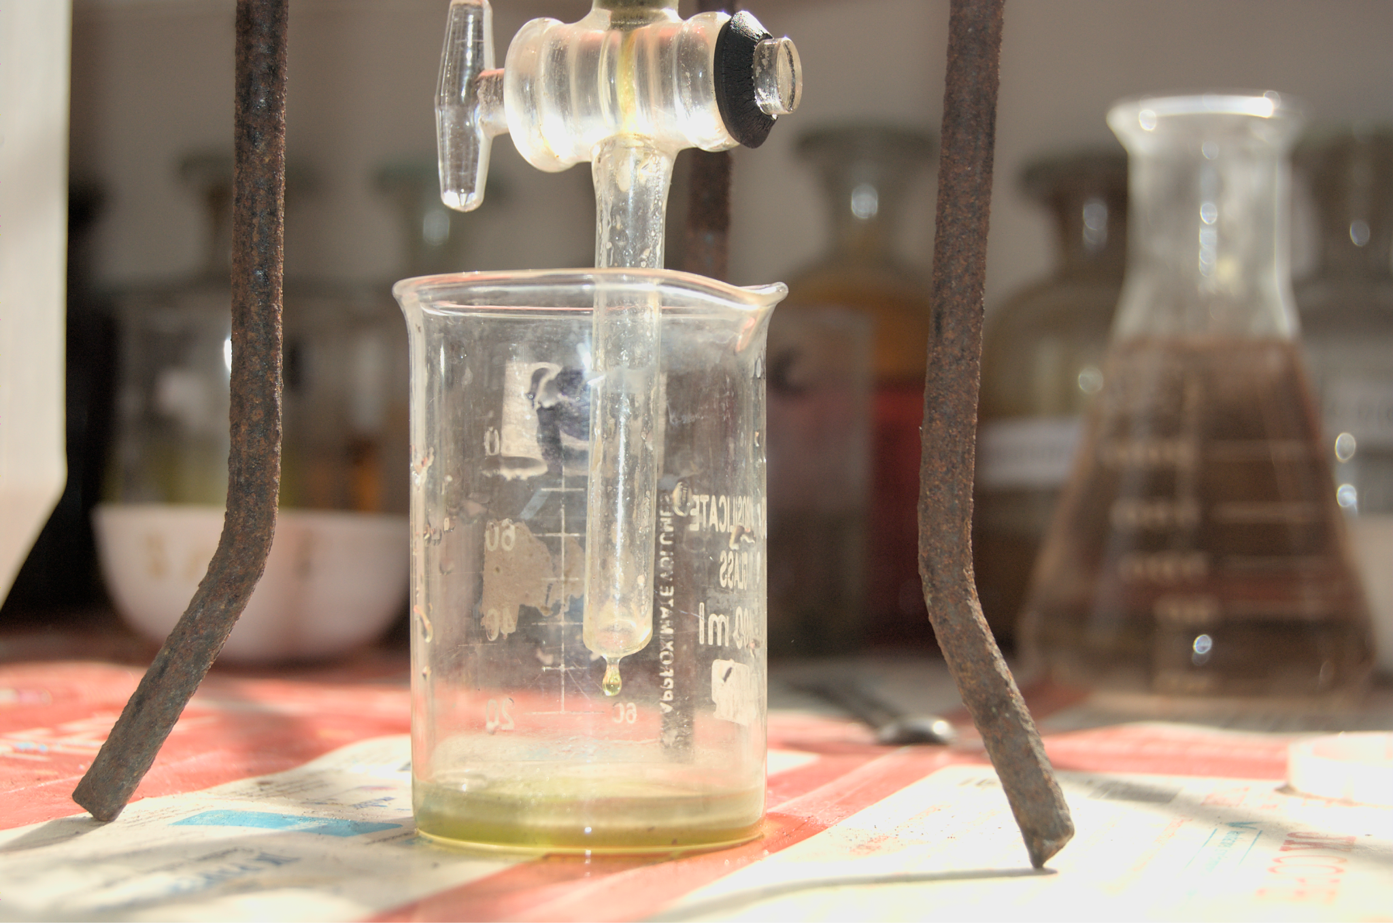
Method
1) Prepare a solution of Chloroform & Methanol (Ethanol) in the ratio 2:1.
2) Weigh the algae. Its weight should be in the ratio 1:5 with the solution.
3) Add 1:4 volume of saline water including the solution & Algae into the separatory funnel.
4) Mix it well & let it rest until distinct layout are seen.
5) Separate the liquid.
6) Double boil the liquid to evaporate chloroform & ethanol.

Slide 8
2) Reduction of FFA content
According to the study, algal oil contains a high FFA content, therefore a pre treatment to reduce the FFA percentage is advised.
There are 4 methods to reduce FFA content:
Acid Pre-Treatment
Glycerolysis
Solid Acid Catalyst
Supercritical Reactors

Slide 9
FUTURE PLAN
To use sewage sludge as an alternative source of biodiesel production. Primary sewage sludge is an efficient source of oil which can be converted into biodiesel.
The use of sewage biodiesel can effectively reduce the problem of short fall of fuel.

Slide 10
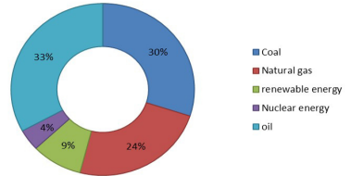
Literature study (https://earthjournalism.net/stories/bengalurus-lakes-spew-toxic-foam-solution-offered-by-biodiesel-entrepreneur-gathers-dust)
reveals…
In addition, the environmental problems associated with excessive usage of fossil consequently limits the utilization of these assets in the future

Slide 11
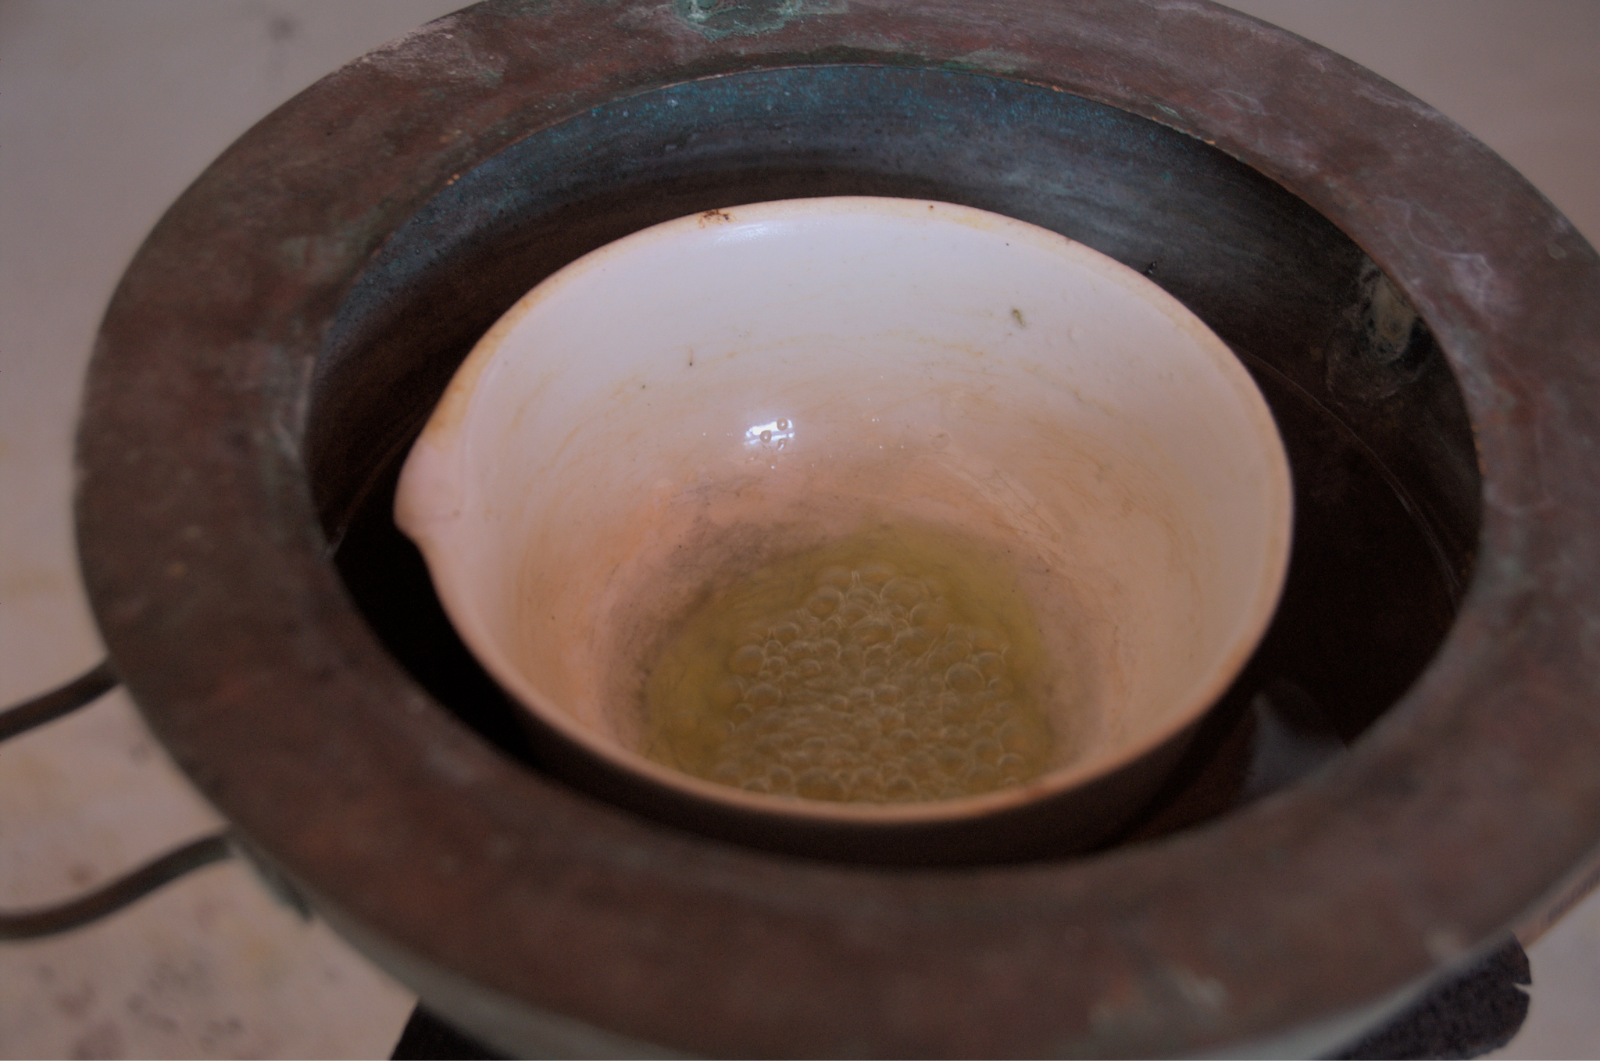
Results and Discussion
The product obtained by our experimental analysis had relatively less efficiency, hence when we went through the literature and found other efficient sources (Sewage –bio lipids) and methods.
We are to out source for the same and continue our literature review.

Slide 12
Conclusions
Currently in India, algae is not much commercially cultivated, it also requires high maintenance, skilled labor and technology.
The product obtained by our experimental analysis had relatively less efficiency, later through the literature study found the other efficient sources (sewage –bio lipids) and methods to extract biodiesel.

Slide 13
References
https://farm-energy.extension.org/used-and-waste-oil-and-grease-for-bio
https://timesofindia.indiatimes.com/india/biofuel-from-algae-to-boost-indias-clean-energy-efforts-scientists-come-out-with-a-new-technique-to-use-this-source/articleshow/77724738.cms
https://www.meddocsonline.org/ebooks/recent-trends-in-biotechnology/biodiesel-from-sewage-sludge-an-alternative-to-diesel.pdf
https://www.meddocsonline.org/ebooks/recent-trends-in-biotechnology/biodiesel-from-sewage-sludge-an-alternative-to-diesel.pdf
https://www.ecoideaz.com/innovative-green-ideas/fuel-from-algae-promises-to-be-a-clean-green-energy-source

Slide 14
Picture Gallery

Slide 15
ACKNOWLEDGEMENT
We are really privileged to be a part of Lake Symposium-2022-2023.
Our sincere thanks, to the Indian Institute of Science, Department of Microbiology-Bangalore University.
We also extend our sincere thanks to our school,all our respected teachers and staffs for guiding us through this project.

Slide 16
THANK YOU

